Slide 1
Static & Dynamic IPv4 Address Assignment to a Host
Notes:
7.1.3.1 Static IPv4 Address Assignment to a Host

Slide 2
IPv4 Communication
Unicast
Broadcast
Multicast
Notes:
7.1.3.3 IPv4 Communication

Slide 3
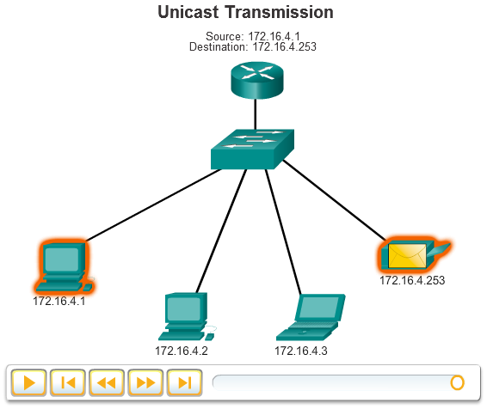
Unicast Transmission
Unicast communication is used for normal host-to-host communication.
The unicast address applied to an end device is referred to as the host address.
The source address of any packet is always the unicast address of the originating host.
Notes:
7.1.3.4 Unicast Transmission

Slide 4
Broadcast Transmission
Notes:
7.1.3.5 Broadcast Transmission

Slide 5
Multicast Transmission
A host sends a single packet to a selected set of hosts that subscribe to a multicast group.
The 224.0.0.0 to 239.255.255.255 range of addresses are reserved for multicast.
Notes:
7.1.3.6 Multicast Transmission
7.1.3.7 Activity – Unicast, Broadcast or Multicast
7.1.3.8 Packet Tracer – Investigate Unicast, Broadcast, and Multicast Traffic

